Slide 1


Data Analysis for Alpine Trekkers Events
Unlocking insights from event participation data.
Enhancing planning, marketing, and engagement through data-driven decisions.
by Durvesh Baharwal

Slide 2


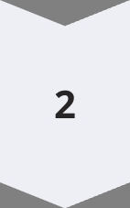
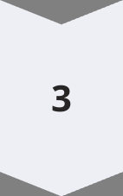
Analysis Objectives
Identify Patterns
Uncover trends in participant demographics and event popularity.
Target Insights
Age groups, popular events, gender distribution, participant frequency.
Enhance Engagement
Improve event planning based on data-driven decisions.

Slide 3

Methodology
1
Tool Selection
Power BI chosen for visualization and dashboard creation.
2
Data Preparation
Loaded and cleaned data for accurate analysis.
3
Visual Creation
Developed visuals for demographics, popularity, and engagement.
4
Performance Tracking
Implemented KPIs to monitor event type performance.

Slide 4

Key Findings
Average Age
25 years
Top Events
Malvan and Andharban
Event Preference
Trips slightly more popular
Gender Distribution
Nearly equal
Top Age Group
20-30 years
Frequent Participants
Top 20 recurring names

Slide 5





Strategic Recommendations
Target Youth
Popular Locations
Event Balance
Loyalty Program
Design events for 20-30 age range.
Increase events in Malvan and Andharban.
Offer both treks and trips.
Implement rewards for frequent attendees.

